Slide 1
Understanding resilience and sensitivity phenotypes in marine species through the lens of systems biology
Shelly Trigg
UW Data Science Postdoctoral Fellow
Steven Roberts Lab
School of Aquatic and Fishery Sciences (SAFS)
University of Washington, Seattle, WA

Slide 2
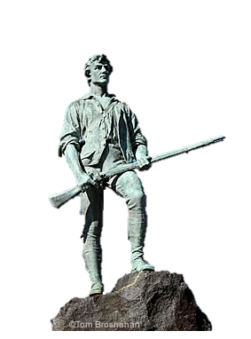

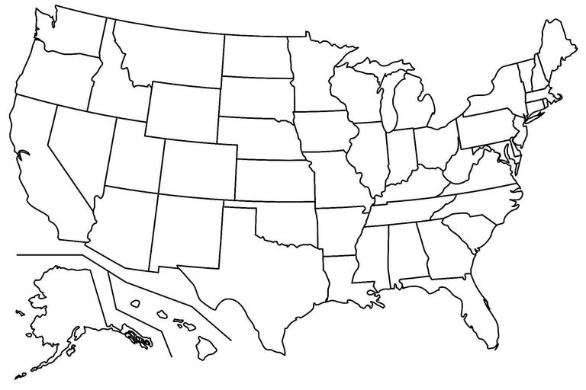
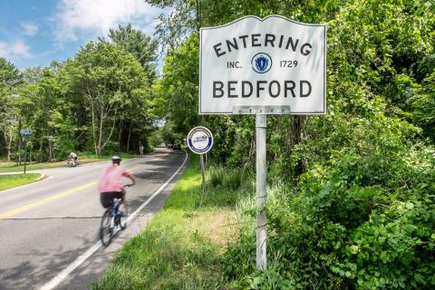
Background
Grew up in Bedford, MA

Slide 3

Background
2010: B.S. in Biochemistry from
Simmons (College) University in Boston

Slide 4


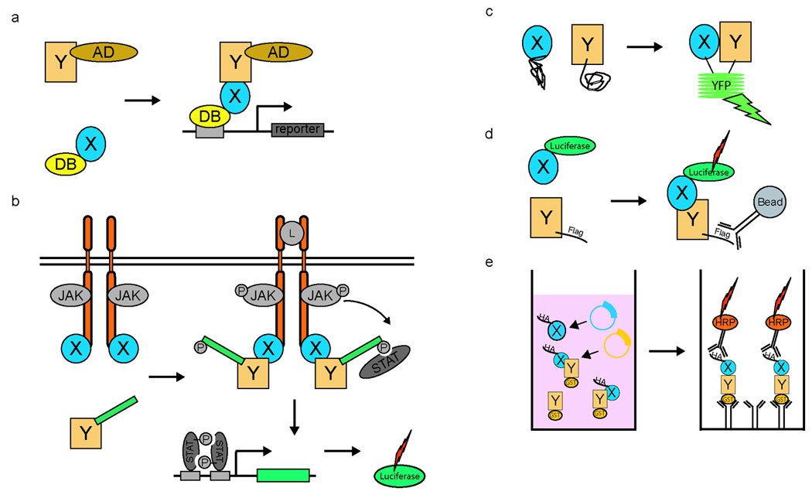
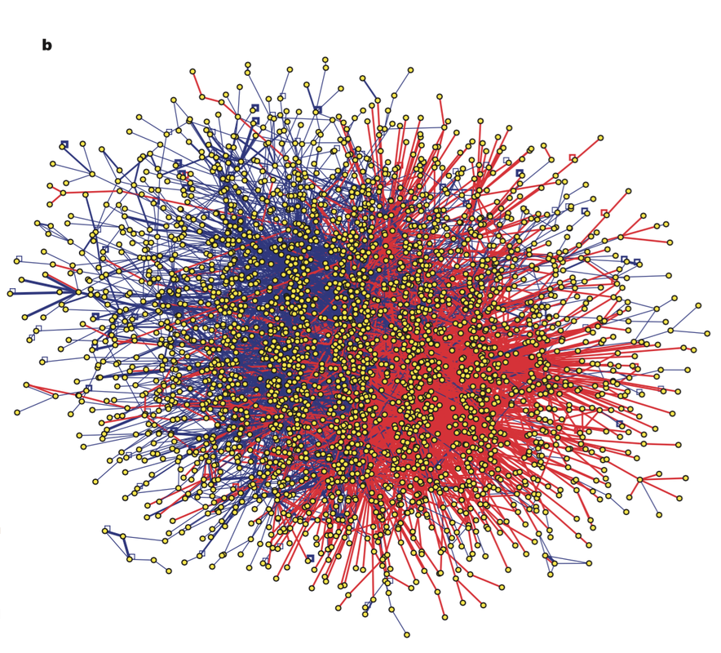
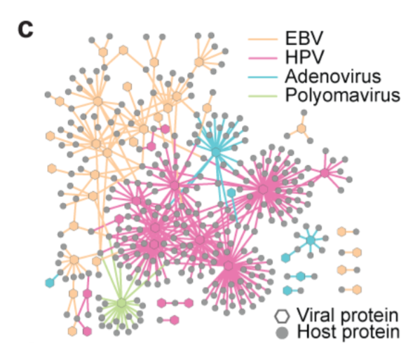
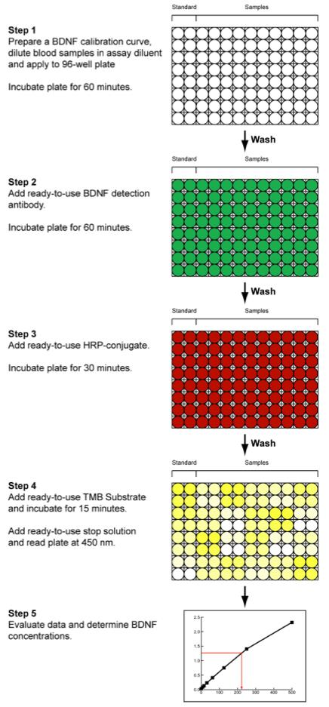
Background
2010: B.S. in Biochemistry from
Simmons (College) University in Boston
Center for Cancer Systems Biology
2010 – 2011: Lab Technician in Marc Vidal’s Lab at the CCSB, DFCI
Protein-protein interaction screening
wNAPPA in vitro TnT
Yeast two-hybrid
Virus-Human interactome (Rosenblatt-Rosen et al. 2011 Nature)
Human interactome (Rolland et al. 2012 Cell)
96-well plate; wells with interactions light up

Slide 5
Background
2010: B.S. in Biochemistry from
Simmons (College) University in Boston
Center for Cancer Systems Biology
2010 – 2011: Lab Technician in Marc Vidal’s Lab at the CCSB, DFCI

Slide 6

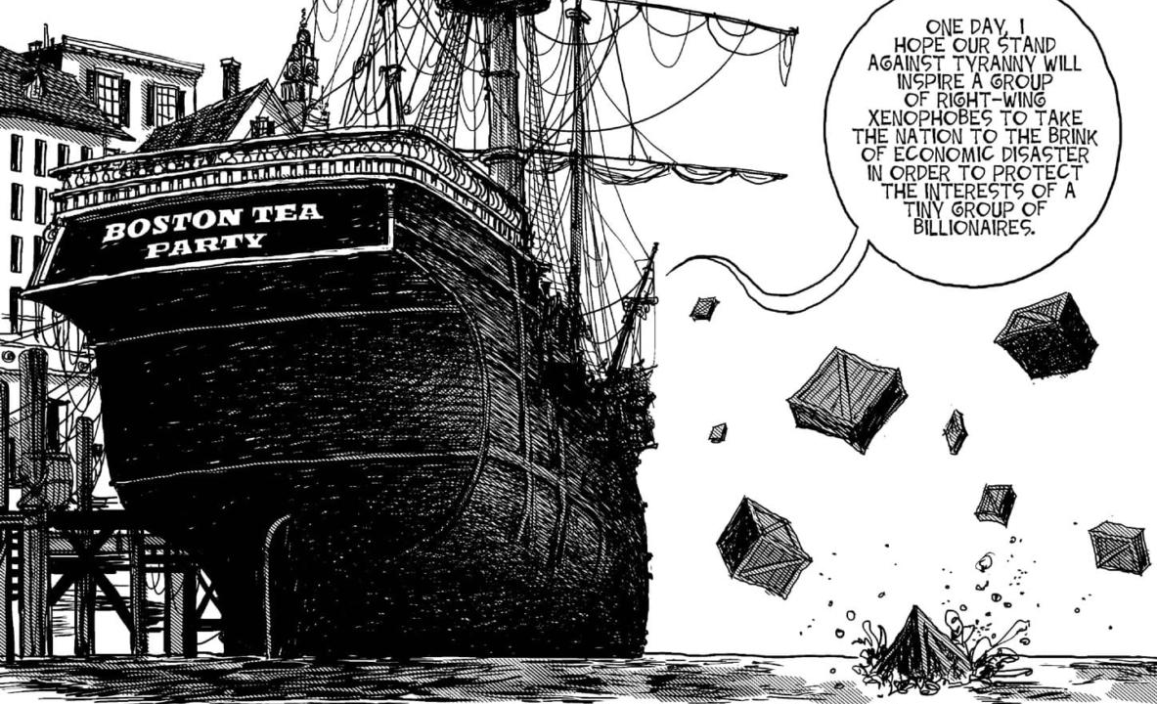




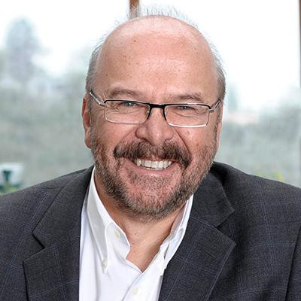
Background
Center for Cancer Systems Biology

Slide 7

Background
x
Center for Cancer Systems Biology

Slide 8



Background
x
Center for Cancer Systems Biology
Notes:
Systems biology in non-model org. How can it be applied? So now I’m going to give a little intro on systems biology

Slide 9
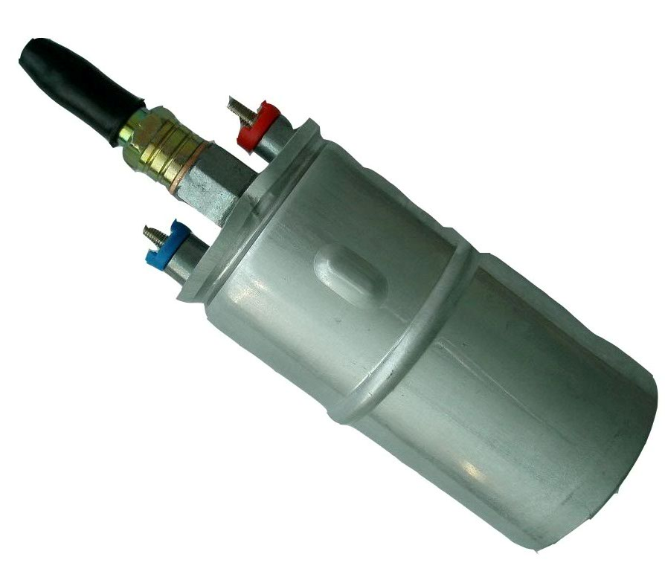
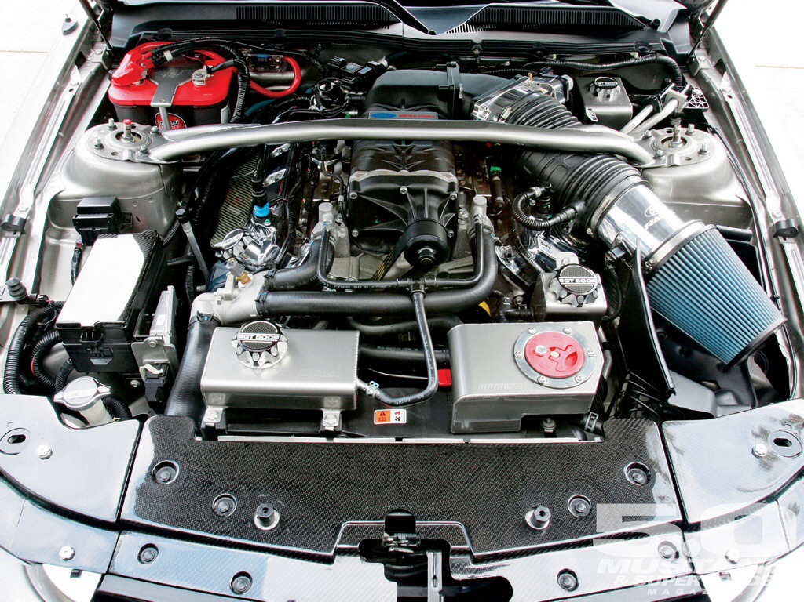
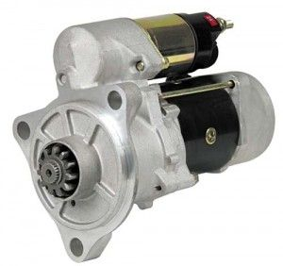
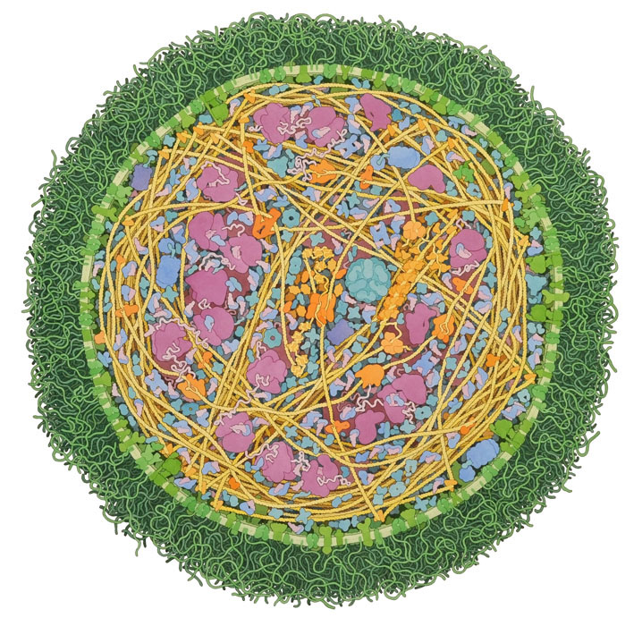



Systems Biology is important
Complex systems = many interconnected parts
Fix one part ≠ always fix the system
One gene ≠ one disease
Individual parts view
System-wide view
air intake
fuel pump
Auto mechanics
starter
ribosome
receptor
Biology
chaparonin
Mycoplasma cell, David Goodsell, TSRI
Notes:
I'm using the term network or systems biology to describe how a of collection of molecules work together to make biological processes happen. Similar to how different car parts work together to make a car run. Cells are like cars in that they are complex systems with many working parts. Knowing a hand full of parts but not how they are connected, makes it hard to diagnose problems when they arise. Like how fixing one part doesn't always fix the system. Or how one gene is not usually the only cause of one disease.
So how can we get this birds eye view of networks in cells?

Slide 10
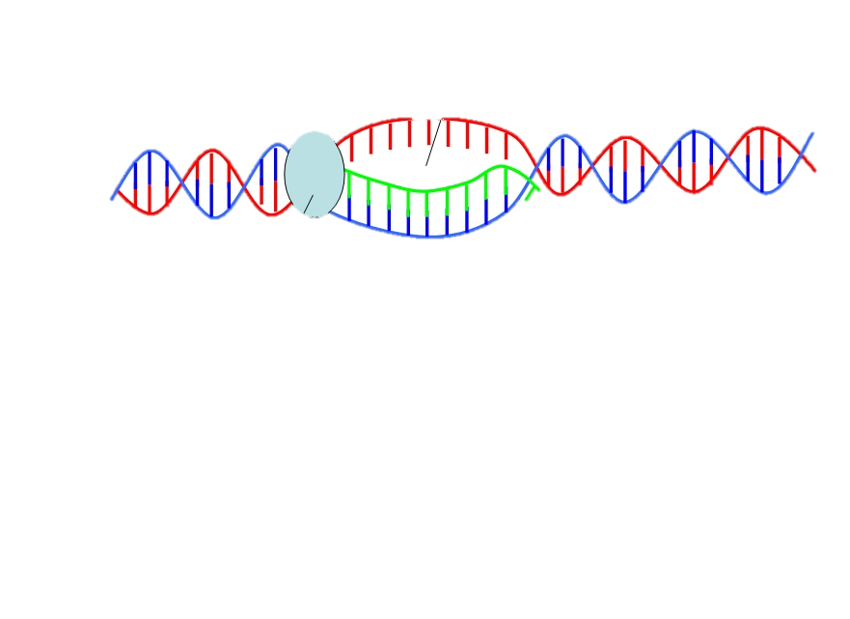
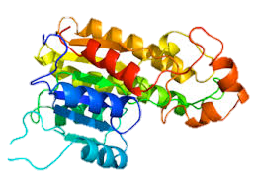
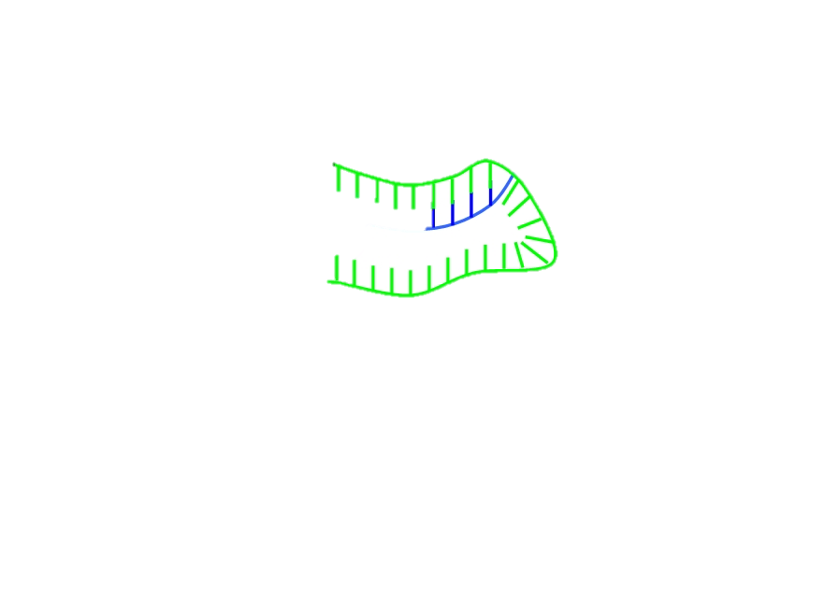
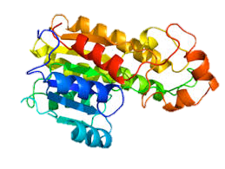
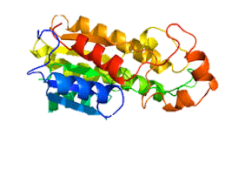
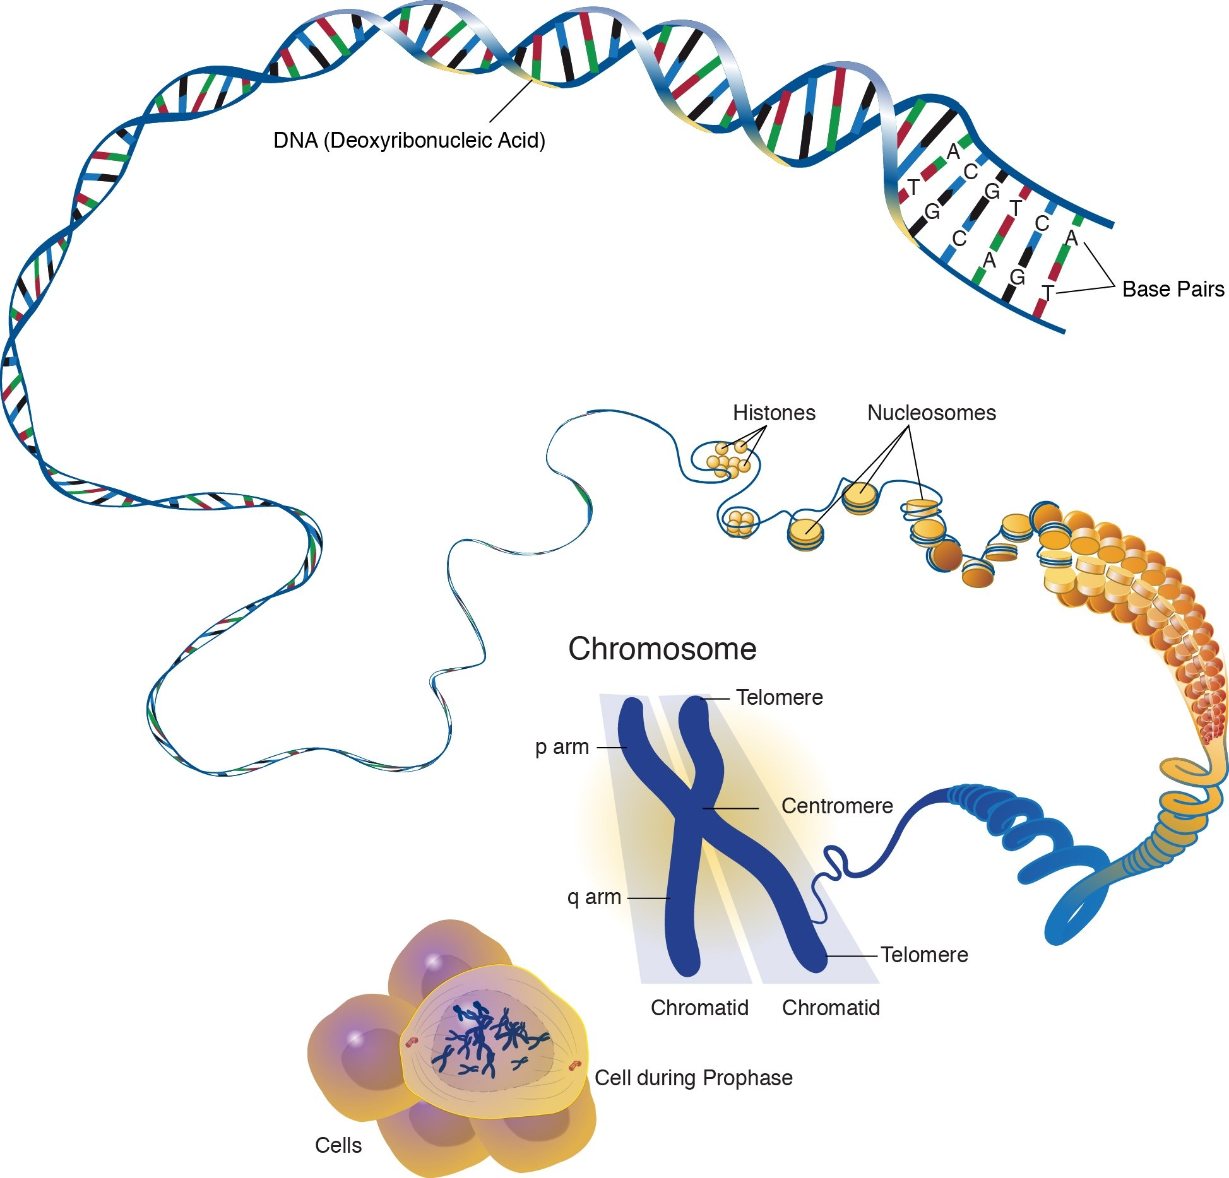
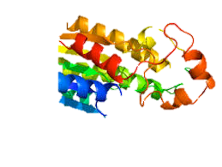
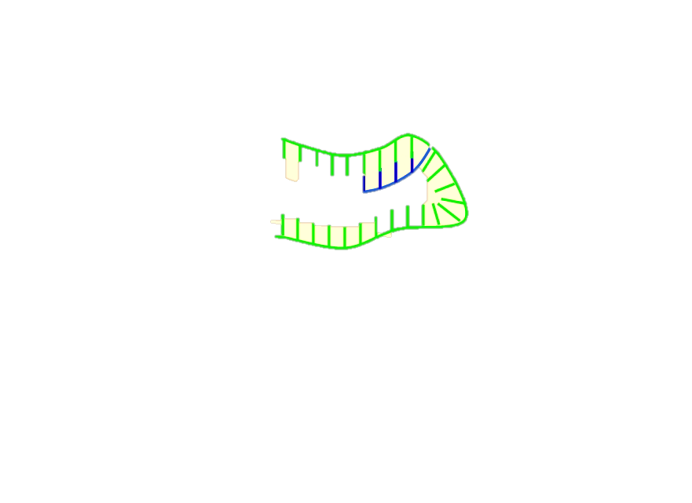

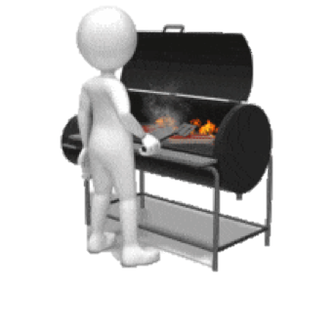





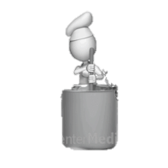
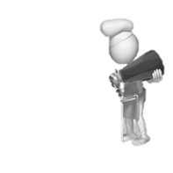
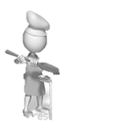
Omics is the study of collections of biological parts
DNA
RNA
DNA
RNA
DNA
RNA
DNA
RNA
DNA
RNA
Genomics
all genes or genetic material
Transcriptomics
all RNA strands transcribed from DNA
Interactomics
all interactions between proteins
Metabolomics
all small molecule byproducts of biochemical reactions (metabolites)
Proteomics
all proteins
Meal prep analogy
Recipe
1.
2.
3.
4.
Notes:
We can use omics technologies. These allow us to see snap shots of collections of biological components, like how genomic sequencing allows us to see all the genetic material in cells. For reference, these different biological components we can look at with omics technologies can be likened to how a big meal is prepared. The genome is the big recipe for cell activity, the transcriptome is like all the orders that get shouted across the kitchen, and call for different sous chefs to come and cook. The sous chefs are like proteins, with each sous chef bringing their own unique skills, and the collection of sous chefs that are called are like the proteome. The sous chefs work together to grill steaks or make soup, just like how proteins with unique activity interact to drive different biological processes. In the end the sous chefs make a whole spread of food similar to the whole spread of metabolites (or metabolome) that get created from proteins working together.
Today I'm going to be focusing on interactomes and metabolomes, but I first want to show you a couple examples of how using omics to get a system-wide view can help us understand biology.

Slide 11
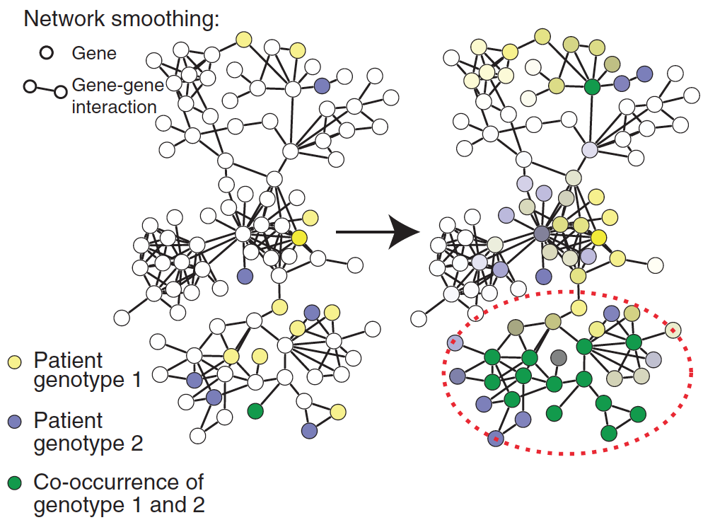

interactome data + genomic tumor data => common networks affected by DNA mutations
Omics data integration in personalized medicine
Network based stratification of tumor mutations predicts prognosis
subtypes defined by affected networks can predict patient response to treatment
Subtype 3
Subtype 2
Subtype 1
Subtype 1
Hofree et al Nat Methods 2013
Notes:
One powerful thing you can do with data generated by omics technologies is integrate different data sets to see a bigger picture. For instance, in this study done in the Ideker lab, found that combining general protein interactome data with genomic data from patient tumors was able to make sense of diverse genetic mutations by identifying commonly affected protein networks. And classifying patients by their affected protein networks was predictive of patient survival and response to therapy.

Slide 12
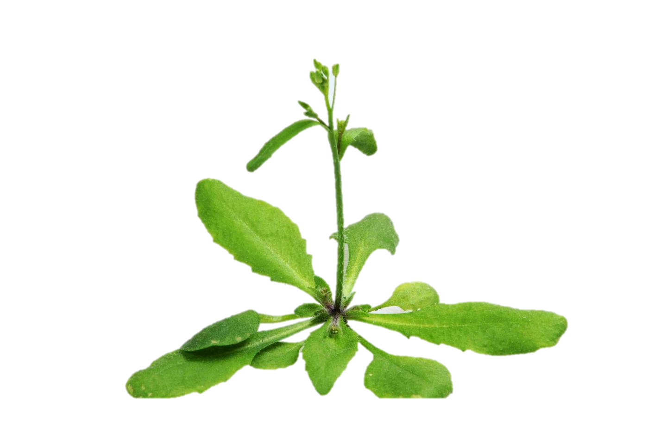
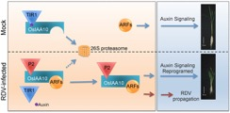
Plant interactome suggests “redundant” proteins in fact have specific roles
OsIAA10 associated with defense response
Jin et al. (2016) PLoS Pathog.
Trigg et al. (2017) Nature Methods
Notes:
Here’s Another example demonstrating the value an omics perspective. Here we are looking at the ARF and AUX-IAA TF family interactions. In the plant world, the interactions between these two families are known signified by the black lines, and these interactions are known to be involved in auxin signaling, which is a plant hormone. IAAs are among the TFs that have genetic redundancy, and what interesting here is that we see IAA proteins interacting with distinct groups of transcription factors, suggesting that IAAs may have specific, non-redundant, functions. For example IAA17 largely interacts with TCP TFs, in contrast to IAA10 which shows interactions with these TFs involved in plant defense. Interestingly in rice, the IAA10 homolog was found to be involved in plant defense in a genetic experiment and this could perhaps be through it’s distinct interactions with these defense associated TFs.

Slide 13
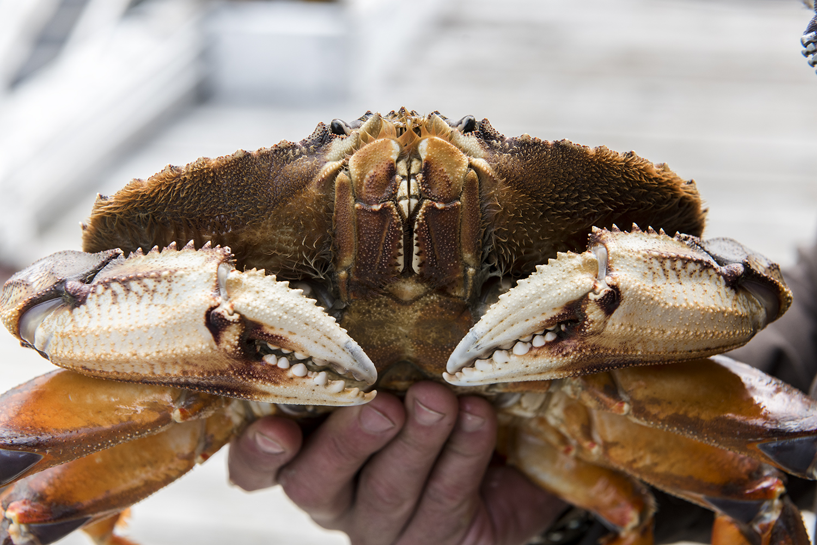
Crab metabolomes show low O2 is a more dominant stressor than low pH
Image by Austin Trigg, austintrigg.com
Trigg et al. (2019) Scientific Reports
Large shapes = significantly affected
Low O₂
Low pH
Low pH + Low O₂

Slide 14
Oyster proteomes show high temperature suppresses early stress response promoting growth
Significantly different proteins show two distinct abundance trends over time
Trigg et al. (2019) in prep

Slide 15


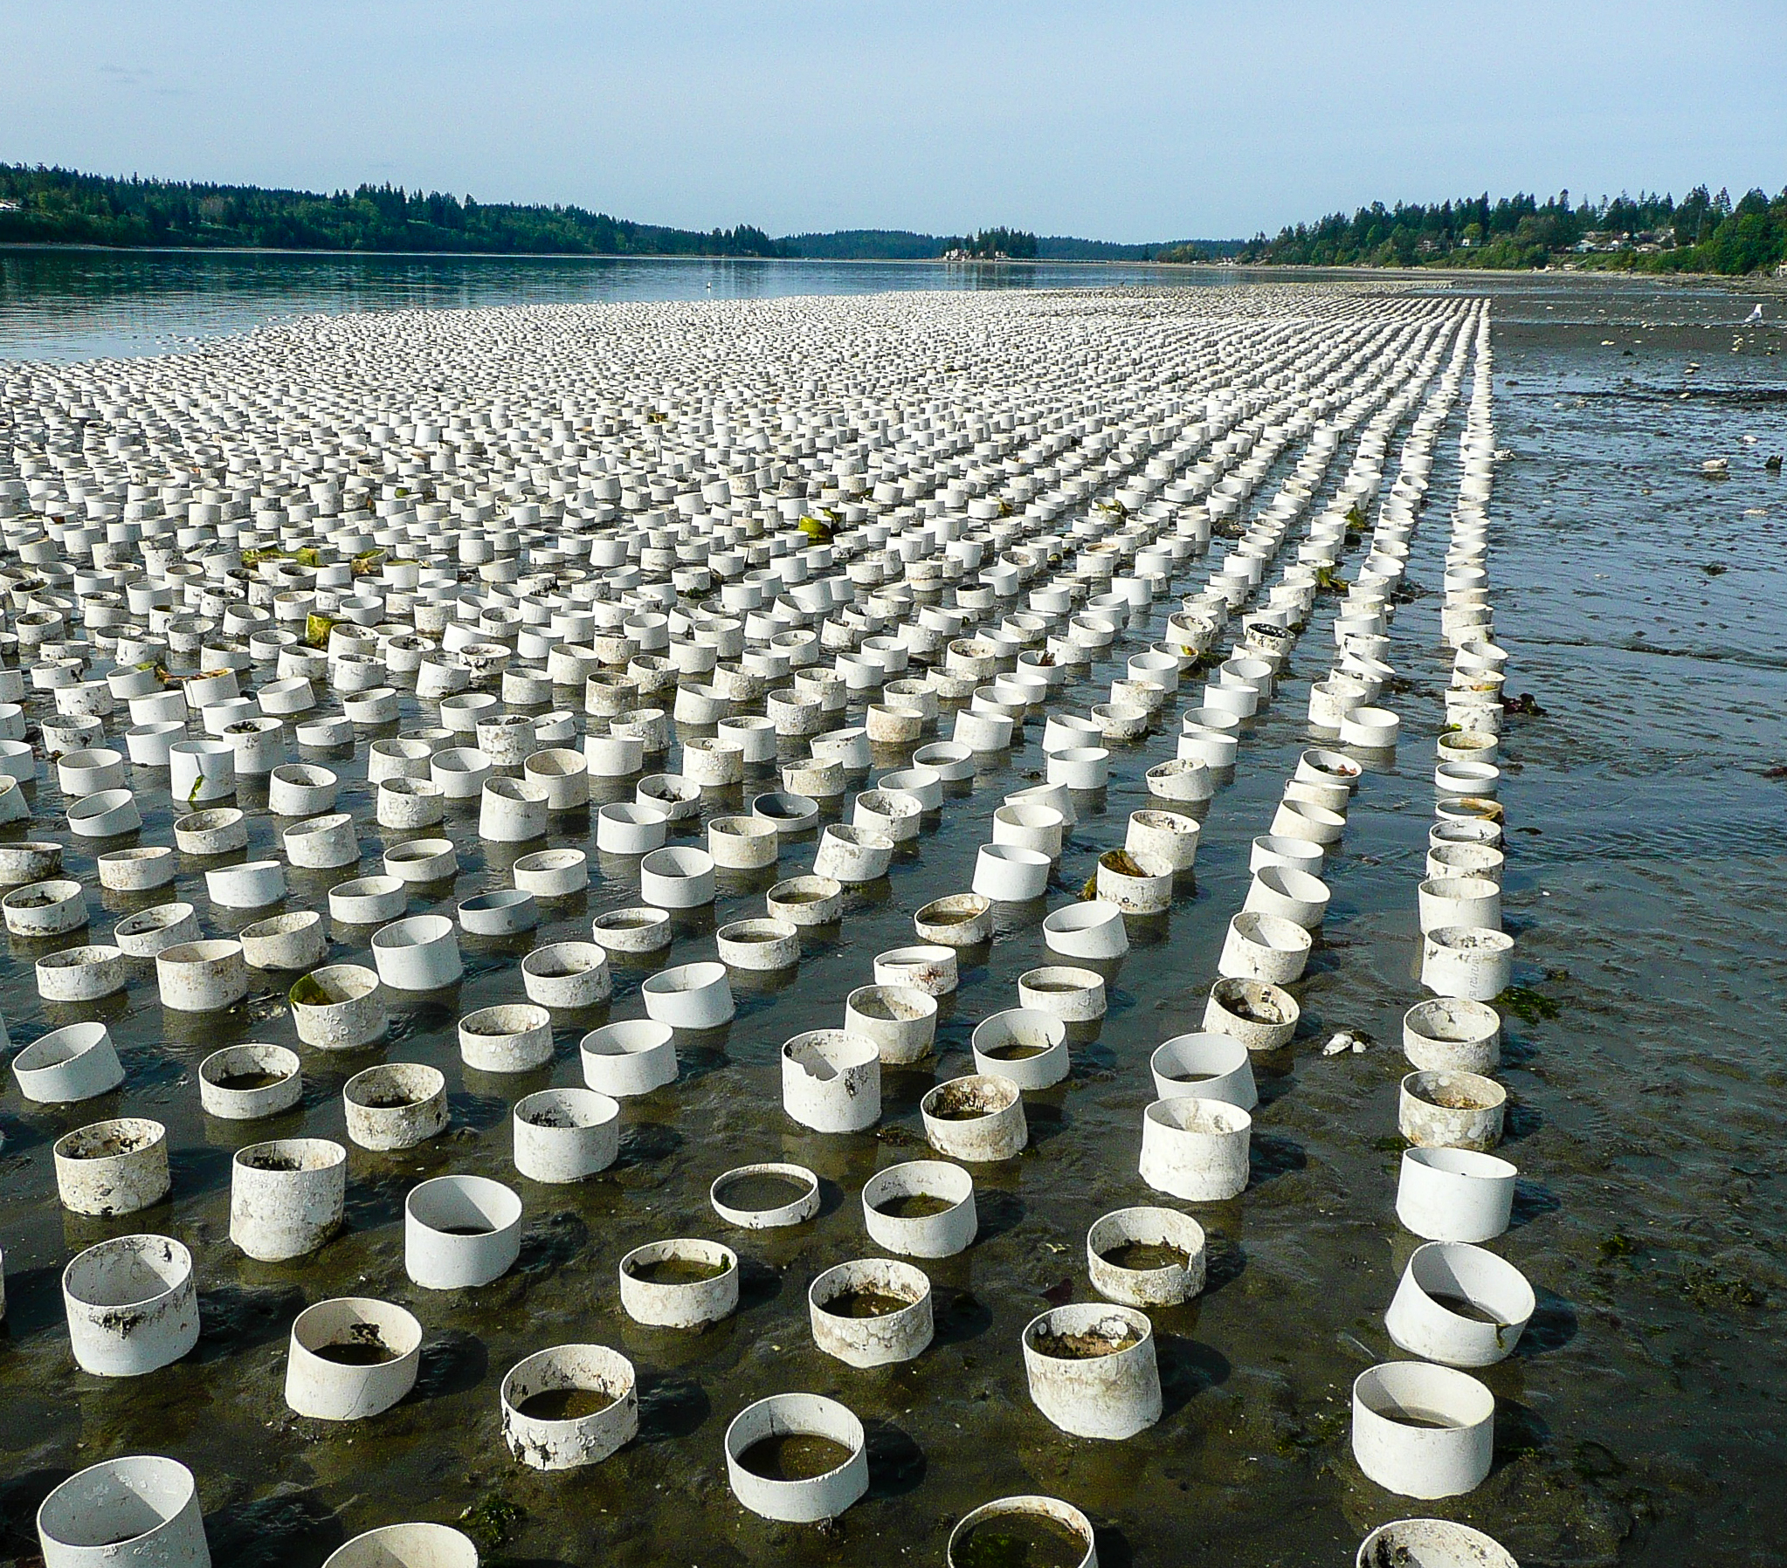


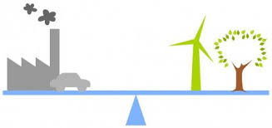
The ultimate goal
Leverage omics environmental response datasets to:
Inform policy
Educate the public
Aquaculture
Conservation
Climate

Slide 16
Where we are at
A lot of data
Epigenomics (DNA methylation)
Transcriptomics
Proteomics
Metabolomics
A lot of different organisms
Oyster
Clam
Salmon
Crab
Coral
An array of field and lab experiments
Different water parameters
CO₂
O₂
Salinity
Temperature
Notes:
Many individual studies. Results don’t all point to the same conclusions. What can we learn collectively from all these studies?

Slide 17
Where we are at
A lot of data
Epigenomics (DNA methylation)
Transcriptomics
Proteomics
Metabolomics
A lot of different organisms
Oyster
Clam
Salmon
Crab
Coral
An array of field and lab experiments
Different water parameters
CO₂
O₂
Salinity
Temperature
High-caliber meta analysis possible
Are there areas of the genome commonly affected by environmental change across species?
Are there common changes associated with resilience vs. intolerance?
Can cross-species data aggregation provide more insight into function?
Notes:
Many individual studies. Results don’t all point to the same conclusions. What can we learn collectively from all these studies?

Slide 18
Challenges
Normalizing between experiments
Different organisms, tissues, and developmental stages
Different conditions
Normalizing data
Data generated by different technologies
Library preparations
Sequencing platforms
Reference genomes of varying quality

Slide 19
Strategies
Open science platforms for
fostering collaboration
transparent, fact-checking process
eScience community!
Notes:
Do people use open science platforms? GitHub, GoogleDrive, Slack. Others? What type of repository management works well? Which have enabled the easiest collaborations? Has anyone done meta-analysis? What have been the best tools/strategies?

